Slide 1
Programming Fundamental Course
Chapter 13 – Understanding OOP

Slide 2
Objectives
After this lesson, you should be able to understand
  Class & Object
  Constructor
  Object Oriented Programming Concept
    Structure Oriented Programming vs OOP
    Inheritance, Polymorphism, Encapsulation

Slide 3
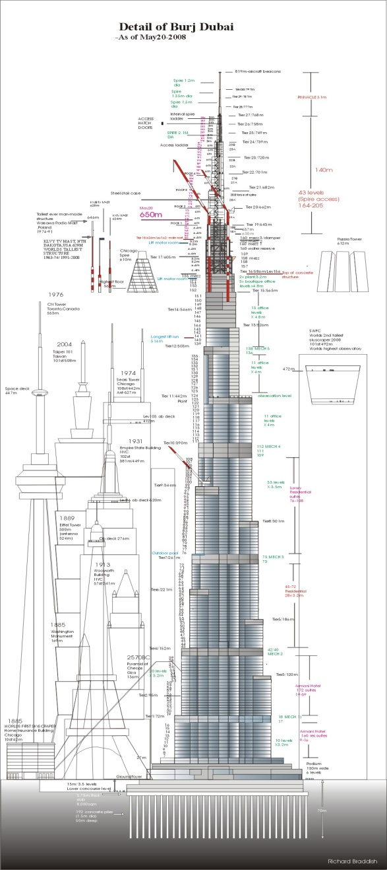

Class Vs Object in programming
Class
  Is a blueprint or prototype
  Defines common variables and methods of a certain kind.
  Include implementation of how it will behave
Object
  Is run-time instance of class
  Behave exactly as implemented in the class
Example
  Home blue print & real home
  Car blue print & real car

Slide 4
Class vs Object in Java
public class Car {
public String LicenseNo;
public void startEngine() {
System.out.println(LicenseNo + "'s engine has started.");
}
public void stopEngine() {
System.out.println(LicenseNo + "'s engine has stopped.";);
}
}
class ClassTest {
public static void main(String[] args){
Car myCar = new Car();
myCar.LicenseNo = "AA/1111";
myCar.startEngine();
Car yourCar = new Car();
yourCar.LicenseNo = "AA/2222";
yourCar.startEngine();
yourCar.stopEngine();
}
}

Slide 5
Class Constructor
To define what to do at the time of object construction
Special method that
Example
public class Car {
public String LicenseNo;
public String Color;
pubic Car(){
LicenseNo = “Not defined”;
Color = “Not defined”;
}
pubic Car(string licenseNo, String color){
LicenseNo = licenseNo;
Color = color;
}
public void showCurrentStatus() {
System.out.println(“License No /t :” + LicenseNo);
System.out.println(“Color /t :” + Color);
}
}
class ClassTest {
public static void main(String[] args){
Car myCar = new Car(“AA/4444”, ”Blue”);
Car yourCar = new Car(“BB/5555”, “White”);
myCar.showCurrentStatus();
yourCar.showCurrentStatus();
}
}

Slide 6
What is OOP?
A programming model/concept
Object based
  Attributes/States
  Methods/Behaviors
  Events/Actions
Object interact with another object to work done

Slide 7
Class & Object in Programming
Car Object
Attributes
  LicenseNo : AA/1111
  Color : Red
  Gear : D
Behaviors
  startEngine
  changeGear
  pushLever
  stopEngine
  changePinion
  changeDashboardStatus
Car Class
Attributes
  LicenseNo
  Color
  Gear
Behaviors
  startEngine
  changeGear
  pushLever
  stopEngine
  changePinion
  changeDashboardStatus
Car Object
Attributes
  LicenseNo : AA/2222
  Color : Blue
  Gear : D
Behaviors
  startEngine
  changeGear
  pushLever
  stopEngine
  changePinion
  changeDashboardStatus
Car Object
………..

Slide 8
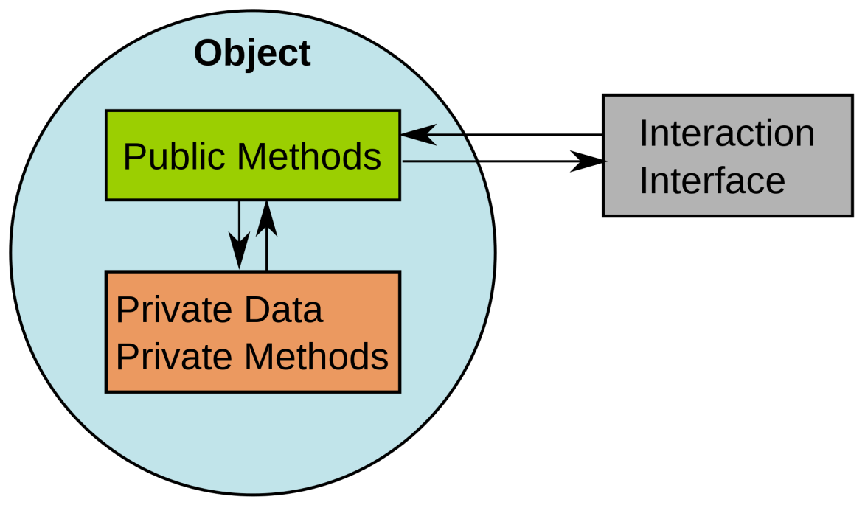
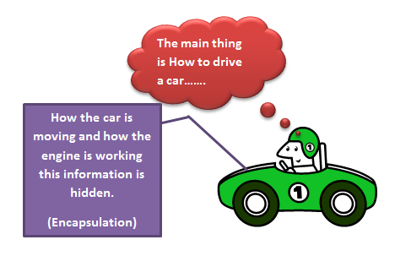
Encapsulation

Slide 9
Encapsulation
Car Object
Attributes
  LicenseNo : AA/1111
  Color : Red
  Gear : D
Behaviors
  startEngine
  changeGear
  pushLever
  stopEngine
  changePinion
  changeDashboardStatus
Car Class
Attributes
  LicenseNo
  Color
  GearNo
Behaviors
  startEngine
  changeGear
  pushLever
  stopEngine
  changePinion
  changeDashboardStatus
Car Object
Attributes
  LicenseNo : AA/2222
  Color : Blue
  Gear : D
Behaviors
  startEngine
  changeGear
  pushLever
  stopEngine
  changePinion
  changeDashboardStatus

Slide 10
Access Modifier
Define/Specify method/variable’s accessibility
Types
  public
    Can be accessed by anywhere
    Internal, derived class, object
  private
    Can be accessed internal only
  protected
    Cab be accessed only by derived class

Slide 11
Encapsulation
Car Object
Attributes
  LicenseNo : AA/1111
  Color : Red
  Gear : D
Behaviors
  startEngine
  changeGear
  pushLever
  stopEngine
  changeDashboardStatus
Car Class
Attributes
  public LicenseNo
  public Color
  public Gear
Behaviors
  public startEngine
  public changeGear
  public pushLever
  public stopEngine
  private changePinion
  public changeDashboardStatus
Car Object
Attributes
  LicenseNo : AA/2222
  Color : Blue
  Gear : D
Behaviors
  startEngine
  changeGear
  pushLever
  stopEngine
  changeDashboardStatus

Slide 12
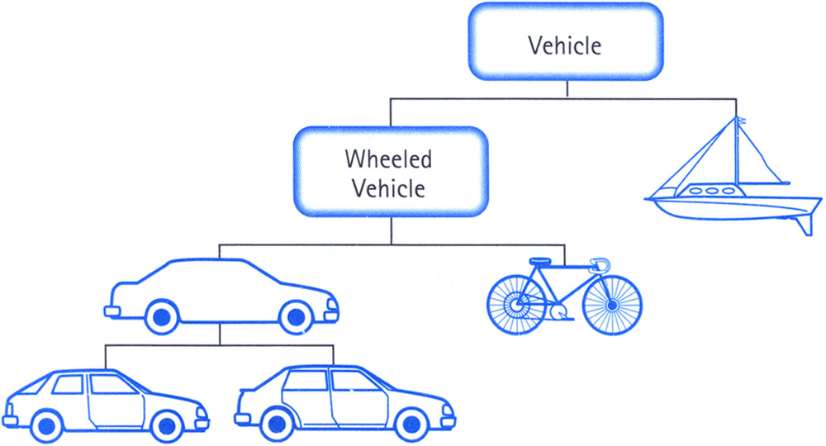
Inheritance

Slide 13
Inheritance
RacingCar Class
Attributes
  LicenseNo
  Color
  GearNo
Behaviors
  Drive
  Stop
LightTruckCar Class
Attributes
  LicenseNo
  Color
  GearNo
Behaviors
  Drive
  Stop
Car Class
Attributes
  LicenseNo
  Color
  GearNo
Behaviors
  Drive
  Stop
TruckCar Class
Attributes
  LicenseNo
  Color
  GearNo
Behaviors
  Drive
  Stop
AirConTruckCar Class
Attributes
  LicenseNo
  Color
  GearNo
Behaviors
  Drive
  Stop

Slide 14
Polymorphism
RacingCar Class
Attributes
  LicenseNo
  Color
Behaviors
  Drive
  Stop
  UseNitro
RacingCar Class
Attributes
  LicenseNo
  Color
  GearNo
Behaviors
  Drive
  Stop
  UseNitro
ManualRacingCar Class
Attributes
  LicenseNo
  Color
Behaviors
  Drive
  ChangeGear
  Stop
  UseNitro

Slide 15
OOP Features
Encapsulation
  Create a package that put only necessary things
  Hide things that doesn’t need to be accessed by external
Inheritance
  Derive everything from parent
Polymorphism
  Derive but change the way the things behave

Slide 16
Any Question?
Class & Object
Constructor
OOP
  Access Modifier
  Encapsulation
  Inheritance
  Polymorphism

Slide 17
Homeworks
Write down the OOP model for following
  Mammal

